Slide 1

Note: The data and information in this document is reflective of a hypothetical situation and client. This document is to be used for KPMG Virtual Internship purposes only.
Sprocket Central Pty Ltd
Data analytics approach
Presented by : Patricia O’Maroro

Slide 2
Note: The data and information in this document is reflective of a hypothetical situation and client. This document is to be used for KPMG Virtual Internship purposes only.
Agenda
Introduction
Data Exploration
Model Development
Interpretation

Slide 3
Note: The data and information in this document is reflective of a hypothetical situation and client. This document is to be used for KPMG Virtual Internship purposes only.
Introduction
Objective of this Presentation
Share key insights on the value of customers through RFM Analysis
Explain model used to determine potential high value customers i.e. variable selected for the model
Provide recommendations of potential customers marketing should target

Slide 4
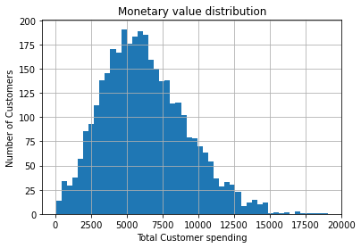
Note: The data and information in this document is reflective of a hypothetical situation and client. This document is to be used for KPMG Virtual Internship purposes only.
Data Exploration
RFM ANALYSIS: A general distribution of recency, frequency and monetary value among customers
Most customers have spent about $5,000 and $6,000. Less than 25 have spent more than $12,500

Slide 5
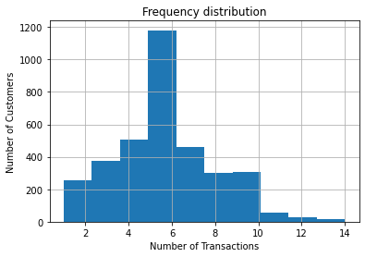
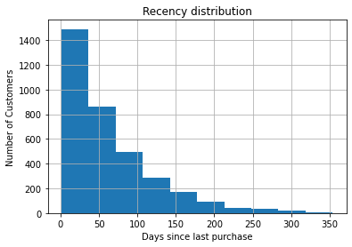
Note: The data and information in this document is reflective of a hypothetical situation and client. This document is to be used for KPMG Virtual Internship purposes only.
Data Exploration: cont’d
Most customers have made an average of 5 to 6 purchases during the year
Most customers made their most recent purchase within the last 50 days. As the recency increases, so does the number of customers

Slide 6
Note: The data and information in this document is reflective of a hypothetical situation and client. This document is to be used for KPMG Virtual Internship purposes only.
Model Development
Variables to consider in model development
State (NSW, VIC, QLD)
Gender (Male, Female, U)
Job industry Category (Financial Services, Manufacturing, Health, Retail, Property, IT, Entertainment, Agriculture, and Telecommunications)
Wealth Segment (Mass customer, High Net Worth, Affluent customer)
Car ownership (Y/N
Age group (10-year gap)
Property Valuation
Tenure
Number of past 3 years bile related purchases

Slide 7
Note: The data and information in this document is reflective of a hypothetical situation and client. This document is to be used for KPMG Virtual Internship purposes only.
Interpretation
Determining which new customers the marketing team should target based on insights from transactions dataset
Target customers from NSW State since 53% of sales come from customers in that region
Target individuals between the ages of 30 and 50 since they bring in around 53% revenue collectively
Target Mass customers as they bring in 50% of total revenue
Target customers in Manufacturing, Finance, and Health job industries as they collectively contribute 70% of the revenue
Target customers who's property valuation is between 6.0 and 9.0
The mean, past bike related purchases is 48 so target customers with above average NB: Gender and whether one owns a bike or not does not affect revenues. The difference is insignificant (2% for car ownership and less than 1% for gender)

Slide 8
Note: The data and information in this document is reflective of a hypothetical situation and client. This document is to be used for KPMG Virtual Internship purposes only.
Interpretation: cont’d
Determining which new customers the marketing team should target based on insights from transactions dataset
Excluding job industry category, there are 18 potential high value customers marketing can target. Their names and list ID are as follows:
56 Briant Ladley
92 Andromache Bonafacino
221 Kort Disley
253 Celeste Fretson
366 Daisi Tinwell
421 Etan Prinett
490 Alexina Mabley
531 Amabel
546 Sammy Borsi
574 Harlene Nono
607 Ajay Worham
608 Jamison Cashin
721 Jaimie Lancastle
724 Calida Schaben
741 Sinclair Wark
808 Davie Blay
905 Olia O' Mullan

